Slide 1
          NRPC SURVEY ON THE USE OF CAPRADAP, CAPRAD and ETC.
        Survey emailed out on April 11, 2018
National Regional Planning Council

Slide 2
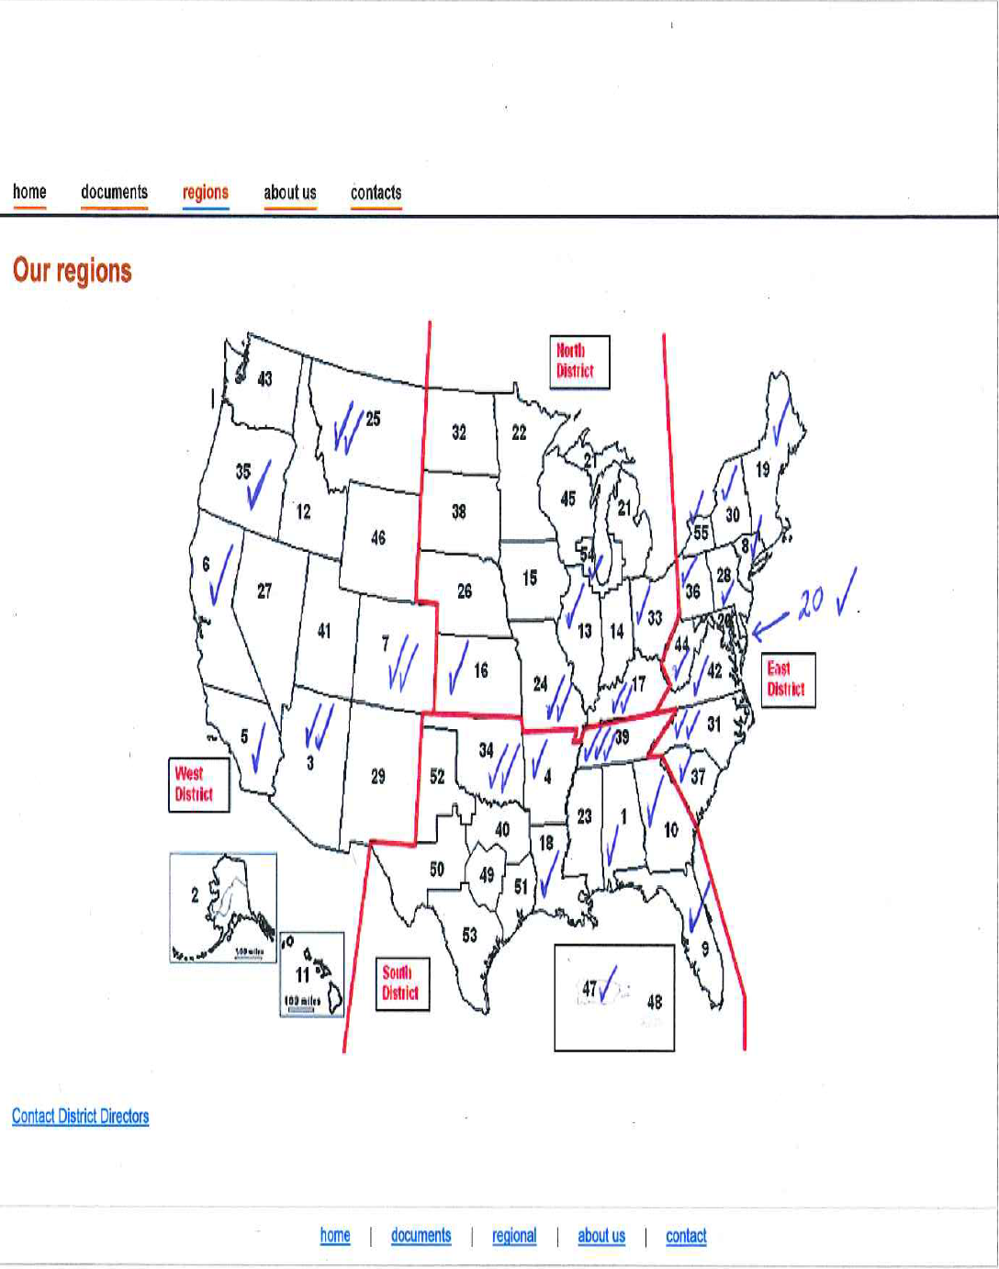
National Regional Planning Council

Slide 3
Percent of RPC’s responding to Survey
West District – 6/14 = 42%
North District - 5/14 = 36%
South District – 8/16 = 50%
East District - 11/11 = 100%
Overall – 30/55 = 55%
National Regional Planning Council

Slide 4
Survey Questions 3 - 5
Q3. Is your RPC Currently using CAPRADAP for new Applications?
Yes – 90%
No – 10%
Q4. Do you plan to use CAPRADAP in the future? If you are not currently using it is there a plan for use; in 1 month, 3 months, 6 months, 1 year, no current plans.
Of the 10% that said no to Q3, 67% said yes in the near future
Q5. What media do you accept applications? Identify all (ex. CAPRADAP only, Paper, Electronic, ALL)
CAPRADAP Only – 33%
Electronic Media which includes CAPRADAP – 95%
Accept Paper Applications as well – 33%
National Regional Planning Council

Slide 5
Survey Questions 6 - 8
Q.6 How does your RPC distribute applications for evaluation to your committee members?
CAPRADAP
Email with attachments
Presentation at meeting
Q.7 Approximately how many business days does it take your RPC to evaluate an application if the application is complete?
Under 30 days – approximately 50%
30 to 60 days – 33%
More than 60 days – 15%
Q.8 In what media format do you send an application to an adjacent Region? Identify all that apply.
CAPRADAP
Email with attachments
National Regional Planning Council

Slide 6
Survey Questions 9 - 11
Q9. In your opinion when your RPC sends an application to an Adjacent Region is the application reviewed and approved/denied in a timely manner?
Yes – 75%
No – 25%
Q10. Approximately how many business days does it take your adjacent region to provide you a decision on an application?
Less than 10 days – 20%
30 to 60 days – 50%
More than 60 days, Not available or Varies – 30%
Q11. Does your RPC use CAPRAD for Media Retention (Current Plan, documents, etc.)?
Yes – 85%
No – 15%
National Regional Planning Council

Slide 7
Survey Questions 12 - 14
Q12. Does your RPC plan to use CAPRAD for Media retention in the Future?
For those that responded no to Q11. 50% Yes and 50% No
Q13. Does your RPC have a World Wide Web address where it stores RPC current plan(s), applications, documents, etc: if yes, please provide:
5 RPC’s responded with a yes – 16%
No – 84%
Q14. Do you plan to use the web for document storage and/or CAPRAD, both, continue to use paper files, use computer/server to store documents, other storage media.
CAPRADAP – 90%
Other -10%
National Regional Planning Council

Slide 8
Survey Questions 15 - 17
Q15. Does your RPC accept vendor provided application engineering or does your RPC have technical people/committee perform the engineering with some engineering application software?
Accept Vendors – 50%
Perform own engineering analysis – 50%
Q16. What Engineering application software does your RPC use to evaluate applications?
ATDI/Spectrum E – 60%
Comstudy/Compass – 20%
Other or None – 20%
Q17. Does your RPC require the applicant provide an import file in Excel or some data format for import into an engineering application?
Yes – 33%
No – 67%
National Regional Planning Council

Slide 9
Survey Questions 18 - 20
Q18. Does your adjacent region accept the engineering you provided or does the adjacent region perform their own engineering analysis?
Accept the Regions – 50%
Perform own engineering – 50%
Q19. On an annual basis, how many meeting does your RPC hold?
1 meeting – 50% (Use Go-to-Meetings, Conference Call Bridge during the year)
2 – 3 meetings - 25%
4 or more – 25%
Q20. Is there any training you would like to take as a NRPC member to better utilize any of the tools the NRPC has provided you with? (EX: 601 filing, CAPRAD, CAPRADAP, ATDI Spectrum E, Application guidelines/Loading, etc)
CAPRADAP, ATDI/SpectrumE and CAPRAD – 75%, yes more training
No, Not at this time. – 25%
National Regional Planning Council

Slide 10
Final Survey Question
Q21. If the training you identified was available at the APCO Conference would you attend?
Yes, 90%
National Regional Planning Council

Slide 11
Discussion
ANY QUESTIONS ?
National Regional Planning Council

